Slide 1









Industry Trend - Applications Are Becoming Digitally Free-Will
Constrained
Boundary-less
Digital Free-will
Use purposeful infrastructure that needs attention and care, constrained by capacity and IT dependency
Build on PaaS, leveraging Infrastructure @ scale through the AKS & be restraint-free.
Exploit, containers, AKS, Edge-computing and infuse cloud nativity making cloud invisible
Application
Abstraction
Low
High
Public Cloud
Public Cloud
Public Cloud
Public Cloud
Infrastructure
Edge
Computing
DC-in-a-Box
Monolithic/nTier IAAS
(Linux Based Application)
Hybrid Cloud
(Containerized)
Azure Kubernetes Service (Container Orchestration)
Purposeful
Scaled
Commoditized

Slide 2
Cloud Migrate Strategy
Rehosting
Lift & Shift
Replatforming
Lift & Shift + Services
Application
Discover/assess/
prioritize
Repurchasing
Replace existing application introducing a standard solution
Refactoring
Refusal of code and development
of a new application
Retire
No Action
Retain
No Action

Slide 3











AKS Business Benefits
Application Centric Operations
ensuring IT agility aligning to Business needs
Business Resiliency
ensuring ‘Always On’ Business Availability
Faster Time To Market
Quicker releases and features to stay ahead of competition
Cost Optimized
Financial Models for greater Predictability
Digital Innovation
driving Digital Enablement & Innovation
Self-Service Models
And Automations
DevSecOps
Auto Scaling
Self-healing Environments
Inclusive Security & Compliance
Comprehensive Governance

Slide 4









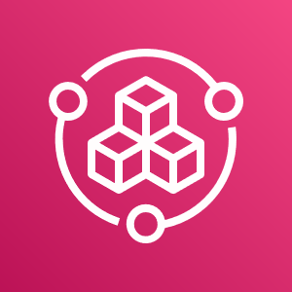


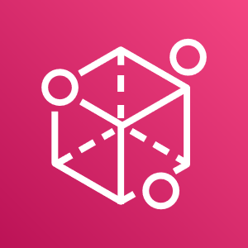





Overall Scope
Cloud
Azure Public Cloud
Build Environment
Target Environments
POC,DEV,QA and PROD
Cloud Model
Platform As A Service (PAAS)
Service
Azure Kubernetes Service
Migration Approach
Migrate the Monolithic Java Based Application to Containars.
Migrate Application
Tooling/Integration
DevSecOps, CI/CD Tools, GIT, Jenkins, Octopus, Nexus and Twistlock. Azure Load Balancer (ALB)
Monitoring
Splunk, AppDynamics and Azure Monitor
AKS Migration
Provisioning
Azure Automation (CLI/Powershell/ARM Templates), / Azure Portal
Orchestration
container, Azure Kubernetes Service
Security
and Compliance Governance
Infrastructure Level
Standard AKS Networking, Azure CNI Model, Network Security Group, Integrate with Azure AD.
AKS Cluster Level
ISTIO ServiceMesh Enablement, Azure Service Principles
Application Level
TwistLock for Application image scanning setup.
Identity
Azure Active Directory, IAM, Single Sign On, Azure Active Directory B2C, Azure Active Directory Domain Services
Self Service
CMDB
ITSM tools – ServiceNow CMDB
Audit
Security Manual Audit, Twistlock and Monitoring logging options ( Cloud Prisma, AppDynamics and Splunk)

Slide 5
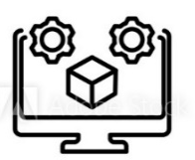








Virtualization Vs Containerization
Virtual
Machines
Containers
Needs a hypervisor and a full OS inside each VM
Bigger footprint – RAM, Storage
Tend to be slower – 2 file systems, 2 operating systems
Tend to be faster
Smaller footprint
Less sophisticated resource management
Resource isolation and allocation of VMs but is much more portable and efficient
vs
VM1
VM2
Container1
Container2
App 1 - N
App 1 - N
App 1
App 2
Bins/Libs
Bins/Libs
Bins/Libs
Bins/Libs
Guest OS
Guest OS
Container Engine
Hypervisor
Host OS
Host OS
Server
Server

Slide 6
Our Point of View – Journey to PasS
TRADITIONAL
DEVSECOPS
LESS OPS
-- App Assessment
Application Modernization
-- App Portfolio rationalization
-- Modernize Legacy in Cloud
-- Modernize Applications
-- Adopt Core Cloud Native Services
-- APM
-- Adopt Containerization,
-- Use IaC for self-service
-- Optimize the code for DevOps
-- Zero downtime Deployments
-- Ops-independent CI/CD
App Path
Synergy
Cloud Path
-- Self-healing
-- Build IaC Pipelines
-- Intelligent Environments
-- Catalogue Building
-- Blue Green Environments
-- AI / ML Infusion
-- Immutable self-healing environments
-- Log Analytics
-Modernize Data
-- RBA / Change Automation
-- Event Correlation and Reduction
-- Modernize Platforms
-- Lift & Shift
Cloud Democratization
Maturity

Slide 7
AKS Building the Framework Modular approach, meeting the customer in journey
Define strategy
Plan & Design
Ready
Adopt :Migrate
Govern
Manage

Slide 8


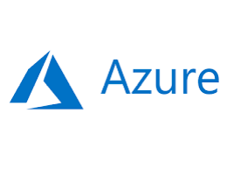








Azure Build Environments
Azure Build Team
ARM Templates
1
Provisioning
Build Environment
2
3
Azure Cloud
Policy
Azure RBAC
Azure virtual Network
Azure Network Security Group
Azure Monitor
Azure Kubernetes Service
Azure Load Balancer
Governance, Security, compliance and Spend Management
Load Balancer and Monitoring

Slide 9






AKS Topology
Management Group
Subscriptions
Resource Group
Virtual Networks
Subnet
Azure Kubernetes Service

Slide 10


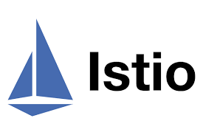






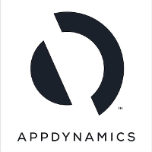



Key Tools Integrated
Azure
Core Features
DevSecOps
Security Tools
Alert and Monitoring
GIT
Jenkins
Azure Kubernetes Service(AKS)
Docker
Azure Load Balancer
Nexus Repo
Helm Templates
Twistlock Defender and Runtime
Azure Virtual Networks
Octopus Deploy

Slide 11



AKS Networking
Dev Sub
Production
SN-AKSPOC-1 /(24)
SN-AKSPROD-1 /(23)
SN-AKSDEV-1 /(24)
SN-AKSQA-1 /(24)
Note: ExpressRoute via VN-AI-UKS-PROD-1 . Need to consult with Global Security for VNet Peering between nonprod and Prod.

Slide 12


AKS NSG –Non Production
VN-AI-UKS-NONPROD-2
SN-AKSPOC-1 /(24)
SN-AKSDEV-1 /(24)
SN-AKSQA-1 /(24)
NSG Ctrl
NSG Ctrl
NSG Ctrl
AKS Cluster
AKS Cluster
AKS Cluster
Node A
Node A
Node A
Azure LB
Node N
Node N
Node N

Slide 13
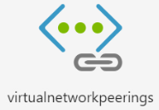
AKS NSG –Production
VN-AI-UKS-PROD-2
VN-AI-UKW-PROD-3
SN-AKSPROD-1
SN-AKSPROD-1
NSG Ctrl
NSG Ctrl
AKS Cluster
AKS Cluster
Node A
Node A
Azure LB
Node N
Node N
Primary Site (UK South)
Stand By Site (UK West)

Slide 14
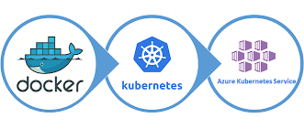
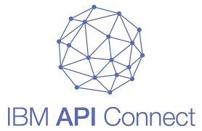
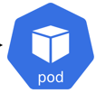





AKS Load Balancer (Strategic)
Azure Kubernetes Service(AKS)
Node 1
Node N
Web Server/Azure App Services
POD 1
POD 1
IBM APIC in Future As per Arch Team
POD N
POD N
http/https
Services A
Azure LB /ISTIO LB
ISTIO Ingress
Controller
POD 1
POD 1
POD N
Services N
POD N

Slide 15



AKS Load Balancer (Strategic)
Azure Kubernetes Service(AKS)
Node 1
Node N
POD 1
POD 1
POD N
POD N
http
Services A
Azure LB
Ingress
Controller
POD 1
POD 1
https
POD N
Services N
POD N
Internet User
Fortinet

Slide 16
AKS Load Balancer (CommsHub)
Azure Kubernetes Service(AKS)
No Change in Existing setup
Node 1
Node N
Web Server
Istio Ingress Controller
http/https
POD 1
POD 1
POD N
POD N
Services A
Azure Load Balancer

Slide 17




AKS Storage (Strategic)
Azure Kubernetes Service(AKS)
Node 1
Node N
Master
POD 1 + PVC
POD 1 + PVC
POD N +PVC
POD N +PVC
Persistent Volume Claim (PVC)
Persistent Volume Claim (PVC)
Persistent Volume
Azure Managed Disk
Azure File Storage

Slide 18



AKS Integrate with Azure Key Vault(Strategic)
Azure Kubernetes Service(AKS)
Node 1
POD 1
1
POD N
Managed Identity
2
http/https
Backend Application
4
Azure LB
POD 1
3
5
POD N
Azure Key Vault Secret Store
Container Storage Interface
Notes:
https://medium.com/swlh/integrate-azure-key-vault-with-azure-kubernetes-service-1a8740429bea
https://docs.microsoft.com/en-us/azure/key-vault/general/key-vault-integrate-kubernetes
. AKS POD Request the Token Using the Managed Identity.
. If AD Successfully authenticated then Token will be issue to POD.
. Token used to authenticate against key vault request a key.
. POD authorization based on assignment permission and request allowed or denied.
. Credentials has been retrieved based on the Key Vault Requested.

Slide 19

ISTIO Cluster –Non Production
VN-AI-UKS-NONPROD-2
SN-AKSPOC-1 /(24)
SN-AKSDEV-1 /(24)
SN-AKSQA-1 /(24)
AKS Cluster
AKS Cluster
AKS Cluster
SN-AKSPOC-1 /(24)
ISTIO Control Plane
Monitored by Splunk

Slide 20
ISTIO Cluster –Production
VN-AI-UKS-PROD-2
VN-AI-UKW-PROD-3
SN-AKSPROD-1
SN-AKSPROD-1
AKS Cluster
AKS Cluster
SN-AKSPROD-1
SN-AKSPROD-1
ISTIO Control Plane
ISTIO Control Plane
Monitored by Splunk
Primary Site (UK South)
Stand By Site (UK West)

Slide 21
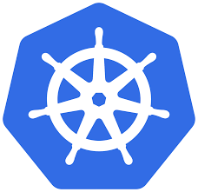




AKS Cluster Setup - ISTIO – Service Mesh
Azure Kubernetes Service(AKS)
PODS
ISTIO
ISTIO
PODS
ISTIO
PODS
ISTIO
Control Pane
Certificate Authority
Network Configuration
Authentication Policy
TLS /SSl Comms

Slide 22
ISTIO – Ingress Option B –DNS Based
MicroservicesA.Aetna.com
MicroservicesB.Aetna.com
Completed
ISTIO Ingress Load Balancer
Microservice A
Microservice B
Microservice C

Slide 23
ISTIO – Ingress Option A –Prefix Based
Microservices.Aetna.com
POC Needed
ISTIO Ingress Load Balancer
/ ServiceA
/ ServiceB
/ Service C
Microservice A
Microservice B
Microservice C
* All App Needs to be in Same Solution Design

Slide 24
AKS Ingress Options
Kubernetes
/CommunicationHub
CommsHub
ISTIO
Virtual Services
/memberconesent
Kubernetes
Gateway
MemberContesent
ISTIO Load Balancer

Slide 25
AKS Splunk Connectivity
Azure Kubernetes Service(AKS)
Node 1
Node N
POD 1
POD 1
POD N
POD N
Splunk Damen
Splunk Damen
Https
Https
Splunk ingest API
Splunk ingest API
hAetna Production Splunk HEC Infrastructure

Slide 26



AKS App Dynamics Connectivity
Azure Kubernetes Service(AKS)
Node 1
Node N
AppD Damen
AppD Damen
POD 1
AppD Init
POD 1
AppD Init
POD 1
AppD Init
POD 1
AppD Init

Slide 27
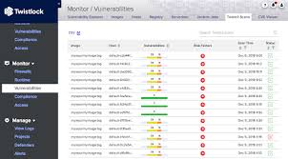



AKS Twistlock Connectivity
Console
Twist CLI
Run Time Screening Images
Registry / Azure resource Screening
Defender
Scanning
Cluster Screening
Nexus Registry
Twistlock Agent
AKS Cluster

Slide 28






Monitoring & Alerting
Monitoring
Alerting
Infrastructure Monitoring
Cluster Monitoring
Omni Bus Event Orchestrator
Application Monitoring
Container Security

Slide 29

















Cloud Native Monitoring & Alerting ( Strategic - Proposed)
Azure Monitor
Insights
Visualize
Metrics
Analyse
Logs
Respond

Slide 30
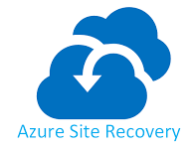

BCDR (Active – Passive – Tier 3 App) - Extended
UK South
UK West
DR Orchestration
DR Orchestration
DB Server
ASR Replication
Primary Site
Web Server
Stand By Site
Azure Storage
ASR Replication
Active Directory
ASR Replication
Primary Site
Azure

Slide 31
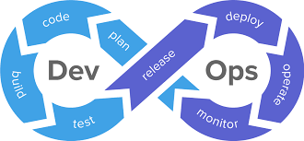



BCDR (Active – Passive – Tier 3 App) - Application Cluster
UK South
UK West
Primary Site
Stand By Site
VN-AI-UKS-NonProd-2
VN-AI-UKW-NonProd-3

Slide 32
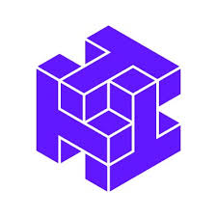




DevSecOps Pipeline
Application Developer
GitHub
Jenkins
Docker
Nexus Repo
Helm Chart
Twistlock
AI DevSecOps Team
Continuous Integration (CI)
1
Promotion Approval
POC Stage
POC
Dev
3
Continuous Deployment
Dev Stage
Application Lead
2
kubectl token
QA
Application Lead
QA Stage
Azure Kubernetes Service
kubectl token
PROD
QA Lead
PROD Stage
DR
kubectl token

Slide 33
Key Deliverables
Design / Build Phase
Execution
Validation
Key Environments
Solution Design Document
AKS Cluster Automation
E2E Application Validation
POC
ISTIO Integration
Network & NSG
Build
Security and Audit Review
DEV
Log Management &
Tools Integration
AppD & Splunk
DevSecOps Build
QA
Performance Testing and Metrics
AKS Build
PROD -UKS
Twistlock Scanning the Images
JBOSS –Tomcat Image Setup
Azure internal LB
DR- UKW

